Slide 1


…a learning cafe
Microservices at Marlinspike
Making Mind Matrix to start new expedition

Slide 2
12 factor Apps
Visual Learn-A Learning CAFE
Making Mind-Matrix @ Marlinspike Hall

Slide 3








BUSINESS TIMELINE INFOGRAPHIC
ADMIN PROCESSES
Run admin/management tasks as one-off processes..
LOGS
Treat logs as event streams.
CODE BASE
One codebase tracked in revision control; many deploys.
DEV/POD PARITY
Keep development, staging, and production as similar as possible.
DEPENDENCIES
Explicitly declare and isolate dependencies.
12 Factor Apps
DISPOSABILITY
Maximize robustness with fast startup and graceful shutdown.
CONFIG
Store config in the environment..
CONCURRENCY
Scale out via the process model.
BACKING SERVICES
Treat backing services as attached resources.
PORT BINDING
Export services via port binding.
BUILD, RELEASE, RUN
Strictly separate build and run stages..
PROCESSES
Execute the app as one or more stateless processes.

Slide 4








12 factor Apps
CODE BASE
One codebase tracked in revision control; many deploys.
codebase
Every Application should maintain Version Control System
…that’s not all this methodology specify
A Codebase can have multiple Deploy
Production
Production
Dev
UAT
Dev
UAT
Visual Learn-A Learning CAFE
Making Mind-Matrix @ Marlinspike Hall
Note

Slide 5



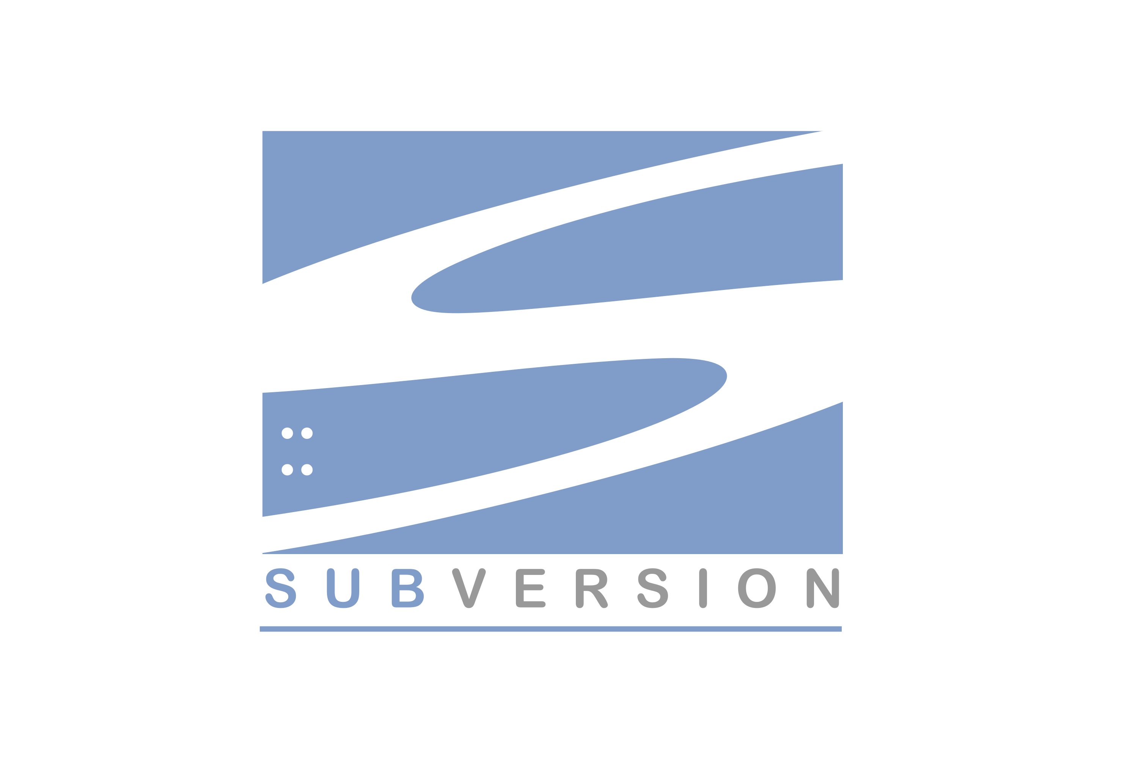
12 factor Apps
CODE BASE
One codebase tracked in revision control; many deploys.
codebase
Decentralized VCS like Git/Mercurial there should set of repo with single root commit
Every application should maintain one dedicated repo or VCS
A Codebase can have multiple Deploy
Production
Dev
UAT
Centralized VCS like Subversion there should be single repo
Visual Learn-A Learning CAFE
Making Mind-Matrix @ Marlinspike Hall
Note

Slide 6

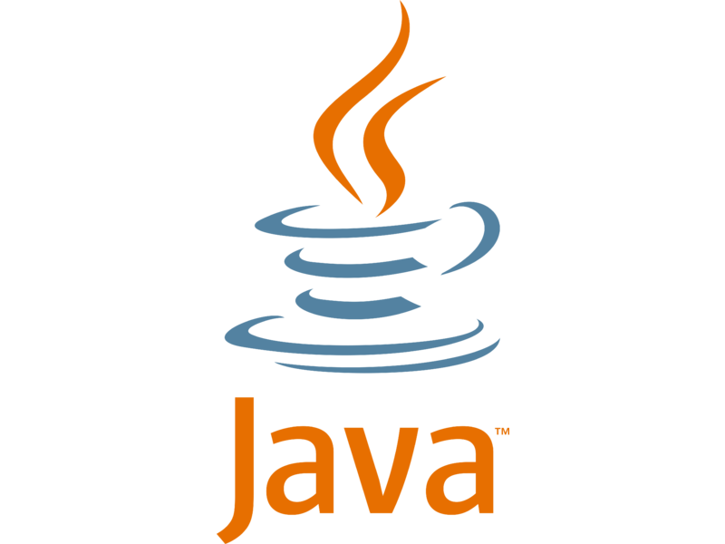




12 factor Apps
DEPENDENCIES
Explicitly declare and isolate dependencies.
Dependency
Declaration Manifest
This file declares all dependencies, completely and exactly whatever required to run
The manifest file is appropriate to the development language.
Also specify the version which need to leverage
Dependency Isolation
ensure no implicit dependencies “leak in” from the surrounding system.
The full and explicit dependency specification is applied uniformly to both production and development
App1
App2
App3
pom.xml
build.gradle
Version 1.1
Version 2.2
Version 1.0
Visual Learn-A Learning CAFE
Bundler for Ruby offers the Gemfile manifest format for dependency declaration and bundle exec for dependency isolation.
Python there are two separate tools for these steps – Pip is used for declaration and Virtualenv for isolation.
C has Autoconf for dependency declaration, and static linking can provide dependency isolation.
Making Mind-Matrix @ Marlinspike Hall
Note: A twelve-factor app never relies on implicit existence of system-wide packages

Slide 7
12 factor Apps
DEPENDENCIES
Explicitly declare and isolate dependencies.
pom.xml
Visual Learn-A Learning CAFE
Making Mind-Matrix @ Marlinspike Hall
Note: A twelve-factor app never relies on implicit existence of system-wide packages

Slide 8
12 factor Apps
CONFIG
Store config in the environment..
There should be strict separation of config from code. Reason, Config varies substantially across deploys, code does not
Production
UAT
DEV
Visual Learn-A Learning CAFE
Making Mind-Matrix @ Marlinspike Hall
Note

Slide 9


12 factor Apps
CONFIG
Store config in the environment..
CONFIG
Store config in the environment..
Visual Learn-A Learning CAFE
Should all configs externalize?
Essentialize? –No, type of config which does not vary between deploys, Please make that part of code.
Making Mind-Matrix @ Marlinspike Hall

Slide 10

12 factor Apps
BACKING SERVICES
Treat backing services as attached resources.
backing services
A backing service is any service the app consumes over the network as part of its normal operation.
Local Services + Remote Services = Backing Service
Backing services are binded by URL
Visual Learn-A Learning CAFE
Making Mind-Matrix @ Marlinspike Hall
Note: binding means backing services are injected in a container during runtime instead of compile time.

Slide 11

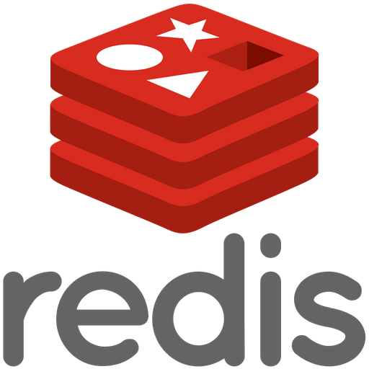
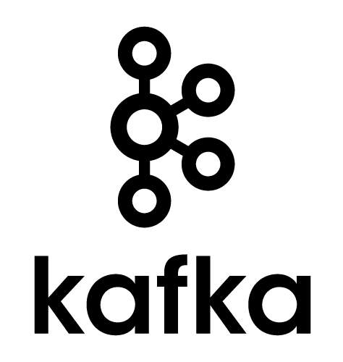

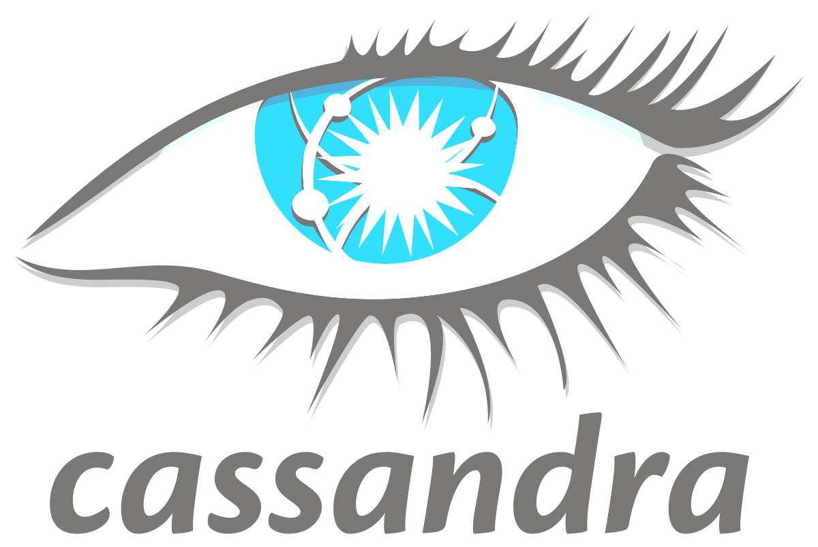

12 factor Apps
BACKING SERVICES
Treat backing services as attached resources.
backing services
A backing service is any service the app consumes over the network as part of its normal operation.
In memory cache
Nosql Databased
Messaging Service
Visual Learn-A Learning CAFE
Making Mind-Matrix @ Marlinspike Hall
Note

Slide 12



12 factor Apps
BUILD, RELEASE, RUN
Strictly separate build and run stages..
+
Build
Release
run
=
Specified commit of code repo
vendors dependencies
executable bundle
+
=
+
=
Visual Learn-A Learning CAFE
Making Mind-Matrix @ Marlinspike Hall
Build:The build stage is a transform which converts a code repo into an executable bundle known as a build. Using a version of the code at a commit specified by the deployment process, the build stage fetches vendors dependencies and compiles binaries and assets.
RELEASE:The release stage takes the build produced by the build stage and combines it with the deploy’ s current config. The resulting release contains both the build and the config and is ready for immediate execution in the execution environment.
RUN:The run stage (also known as “runtime”) runs the app in the execution environment, by launching some set of the app’s processes against a selected release

Slide 13


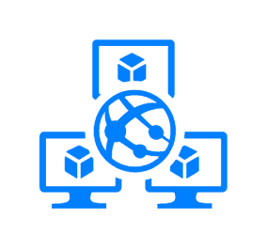

12 factor Apps
PROCESSES
Execute the app as one or more stateless processes
All process should be stateless and share nothing, Any data that needs to persist must be stored in a stateful backing service, typically a database.
A standalone java application launched through “javac” command in developer system
A production grade, sophisticated app may use many process types, capable to instantiate into zero or more running processes with complex code
Fundamental characteristics should be same, No guarantee that data in memory will be available outside the runtime of current process
Even when running only one process, a restart (triggered by code deploy, config change, or the execution environment relocating the process to a different physical location) will usually wipe out all local (e.g., memory and filesystem) state.
An enterprise application anything cached in memory or on disk will be available on a future request or job reason a future request will be served by a different process.
Visual Learn-A Learning CAFE
Certified Diplodocuses. What stopping you not to use hieroglyphs!!!
Making Mind-Matrix @ Marlinspike Hall
Normal hello world program or high-end application both maintain fire & forget mechanism, once the process end the successive call is nothing but a new call

Slide 14
12 factor Apps
PROCESSES
Execute the app as one or more stateless processes
Process centric view
Application themselves are deployed like one or more processes instead of embedding them in one process
Visual Learn-A Learning CAFE
Certified Diplodocuses. What stopping you not to use hieroglyphs!!!
Making Mind-Matrix @ Marlinspike Hall
Note:

Slide 15




12 factor Apps
There should not be any separate service which handle all request and response rather the application itself will handle the protocol of communication by binding to a port and listening to requests coming in on that port.
The port should be nonstandard port allowing to run in container in isolated fashion.
How Port binding deal in different environment?
In development environment port binding done manually either by local environment variable or command line parameter
In deployment environment there should be some routing technology manage all communication
Visual Learn-A Learning CAFE
By Port binding our service can access other service as Backward service
To be precise; by port binding our service can be accessed as backward service by other service
Making Mind-Matrix @ Marlinspike Hall
Note

Slide 16
12 factor Apps
Visual Learn-A Learning CAFE
Making Mind-Matrix @ Marlinspike Hall
Note

Slide 17

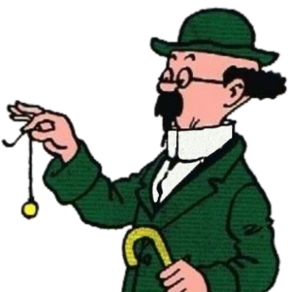
12 factor Apps
CONCURRENCY
Scale out via the process model.
instance
Both cases we are leveraging wasteful nature reason for Vertical scaling we are increase horse power of entire system or Horizontal scaling we spawn up new instance of entire system.
instance
instance
instance
instance
instance
instance
instance
instance
instance
instance
instance
instance
instance
instance
instance
instance
Vertical Scaling
Horizontal Scaling
Visual Learn-A Learning CAFE
Which scaling is good? Need to consult with Professor!!!
To be precise, need to consult with professor which scaling is good?
Making Mind-Matrix @ Marlinspike Hall
Selling. Why you are thinking about selling before scaling ; Both cases there are wastage of resource…think about more Scaling!... more scaling !...more scaling!!!

Slide 18
12 factor Apps
CONCURRENCY
Scale out via the process model.
instance
instance
instance
instance
instance
instance
instance
instance
instance
instance
instance
instance
instance
instance
instance
instance
instance
instance
instance
instance
instance
instance
instance
instance
Visual Learn-A Learning CAFE
Making Mind-Matrix @ Marlinspike Hall

Slide 19
12 factor Apps
DISPOSABILITY
Maximize robustness with fast startup and graceful shutdown.
fast startup
graceful shutdown
Processes should strive to minimize startup time, only few seconds from the time the launch command is executed and the process is up and ready to receive requests or jobs.
Essential components which require immediately to make the process functional include in startup often through parallel task.
What is not needed Immidiately make out of start up routine, may be when first call comes.
Processes shut down gracefully when they receive a SIGTERM signal from the process manager.
Immediately it start of refusing any new requests & allowing only current requests to finish, and then exiting.
It also includes storing appropriate data to the datastore or cache so that other processes can pick that information up.
Visual Learn-A Learning CAFE
Making Mind-Matrix @ Marlinspike Hall
Note For a web process, graceful shutdown is achieved by ceasing to listen on the service port

Slide 20

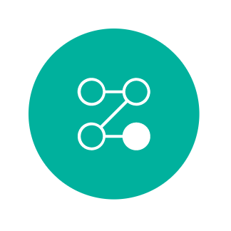

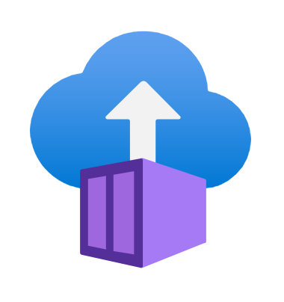




12 factor Apps
DISPOSABILITY
Maximize robustness with fast startup and graceful shutdown.
Security
Scalability
Fault
Tolerance
Auto scalable easily achieve by this model
Higher load container can increase load dynamically
Visual Learn-A Learning CAFE
Catastrophic Cannibal(s)!!!...willing to take my life??? What else I have to do follow this craps!!!!
Making Mind-Matrix @ Marlinspike Hall
Captain, be smart like Tintin, framework like Spring Boot, Node module leverage this,
Make a cheers for my awesome idea and think about the policy I am proposing….

Slide 21

12 factor Apps
DISPOSABILITY
Maximize robustness with fast startup and graceful shutdown.
Security
Visual Learn-A Learning CAFE
Catastrophic Cannibal(s)!!!...willing to take my life??? What else I have to do follow this craps!!!!
Making Mind-Matrix @ Marlinspike Hall
Captain, be smart like Tintin, framework like Spring Boot, Node module leverage this,
Make a cheers for my awesome idea and think about the policy I am proposing….

Slide 22
12 factor Apps
DISPOSABILITY
Maximize robustness with fast startup and graceful shutdown.
Visual Learn-A Learning CAFE
Making Mind-Matrix @ Marlinspike Hall
Note

Slide 23


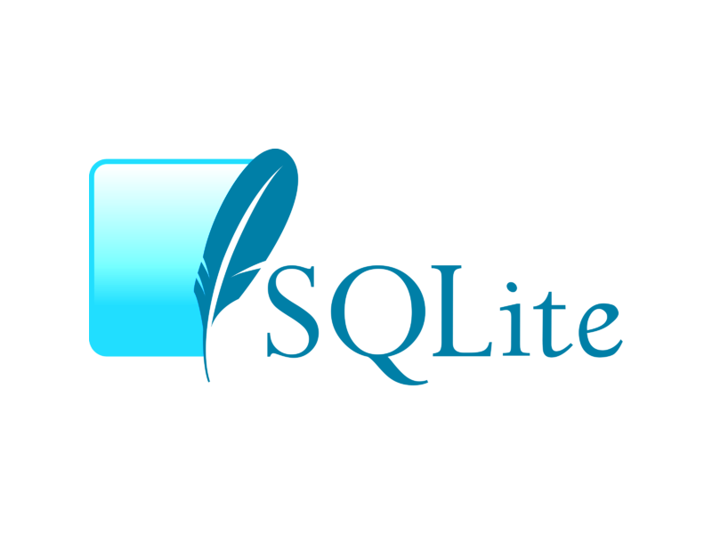
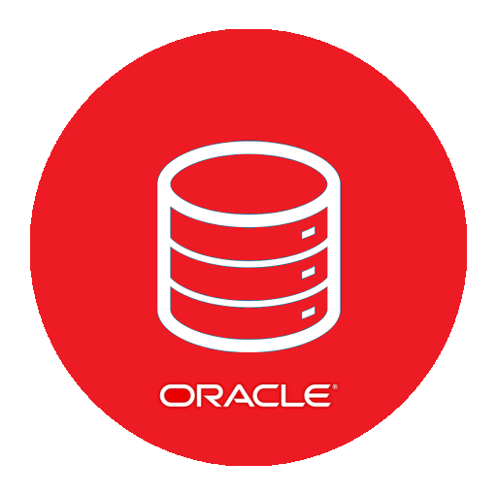

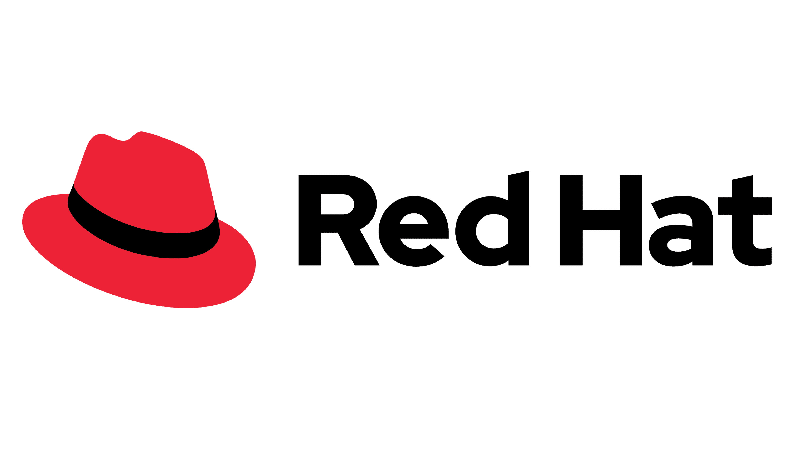

12 factor Apps
DEV/POD PARITY
Keep development, staging, and production as similar as possible.
Visual Learn-A Learning CAFE
Making Mind-Matrix @ Marlinspike Hall
Note

Slide 24
12 factor Apps
LOGS
Treat logs as event streams.
Visual Learn-A Learning CAFE
Making Mind-Matrix @ Marlinspike Hall
Note

Slide 25
12 factor Apps
Visual Learn-A Learning CAFE
Note

Slide 26


12 factor Apps
ADMIN PROCESSES
Run admin/management tasks as one-off processes.
Running Batch Job
Report generate
Records inspection
Clean-up Cache
Administrative
Check database
Asynchronous method call
task
Legacy application it was part of Main application
Some event that occur regular interval
A batch job running regular interval
Asynchronous job that spawn time to time
12 Factor app this administrative tasks are treated as First-class process that is all administrative task will run separately.
Visual Learn-A Learning CAFE
Administrative task.. That necessary evils – Billions & Billions of blue blistering barnacles!#@#*!
Making Mind-Matrix @ Marlinspike Hall
Making Mind-Matrix @ Marlinspike Hall
I have a solution Captain…make administrative task out of your 12 factor apps
And treat it like another 12 factor app

Slide 27
12 factor Apps
DEPENDENCIES
Explicitly declare and isolate dependencies.
Visual Learn-A Learning CAFE
Making Mind-Matrix @ Marlinspike Hall
Note

